Slide 1

Chapter 02
Fundamental Principles
CONCEPTS OF ECONOMICS

Slide 2


Concepts of Economics
1. Opportunity Cost
Fundamental Principles

Slide 3
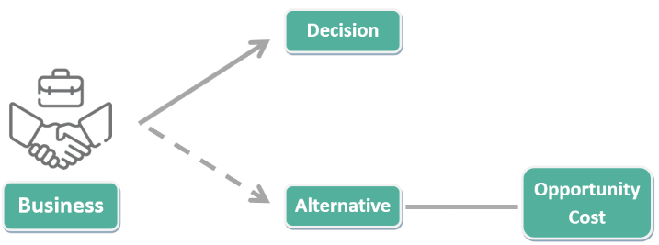
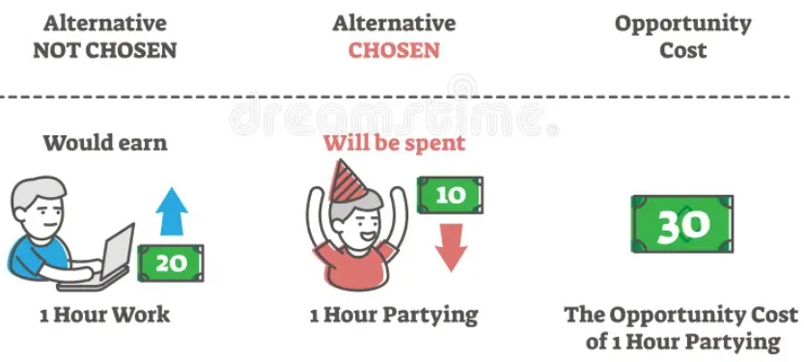
Concepts of Economics
1. Opportunity Cost
Fundamental Principles

Slide 4
1. Opportunity Cost - Examples
Concepts of Economics
Education vs Work
If a person decides to pursue a full-time degree, the opportunity cost is the potential income they could have earned by working during that time.
Investing
Choosing to invest money in one stock instead of another means giving up the potential gains or benefits from the alternative investment.
Time Allocation
Spending time on leisure activities might mean sacrificing the opportunity to develop new skills or engage in productive endeavors.
Business Decisions
A company deciding to invest its resources in expanding Product A may miss out on the opportunity to invest in the potentially more profitable Product B.
Fundamental Principles

Slide 5
1. Opportunity Cost - Examples
Concepts of Economics
Government Spending
When a government allocates funds to one sector (e.g., defense), it may reduce the resources available for other sectors like education.
Personal Expense
Choosing to spend money on a luxury vacation might mean giving up the opportunity to save for a down payment on a house.
Entrepreneurship
An entrepreneur starting a new venture may sacrifice a stable job with a regular income in pursuit of potential long-term business success.
Natural Resource
A country exporting its natural resources may gain revenue but lose the opportunity to use those resources for domestic development.
Fundamental Principles

Slide 6
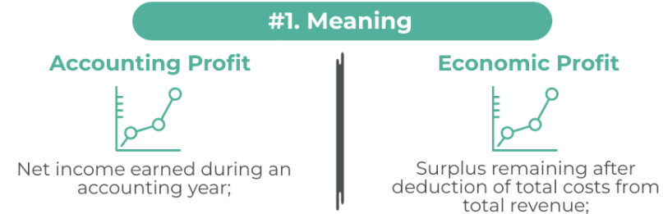
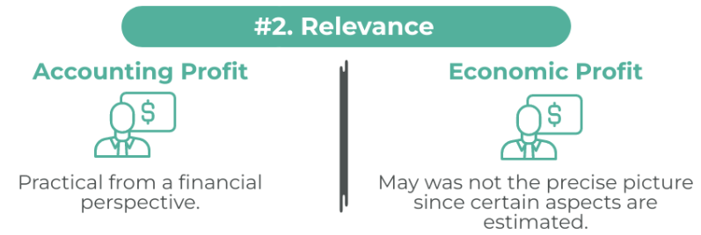
Concepts of Economics
1. Opportunity Cost
Accounting Profit VS Economic Profit
Fundamental Principles

Slide 7
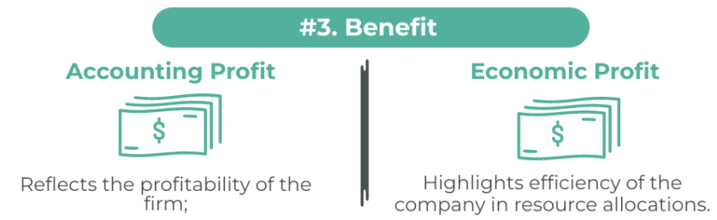
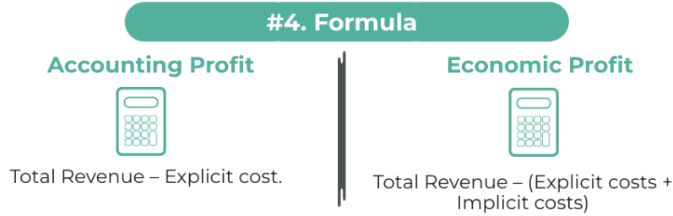
Concepts of Economics
1. Opportunity Cost
Accounting Profit VS Economic Profit
Fundamental Principles

Slide 8
Concepts of Economics
1. Opportunity Cost
Accounting Profit VS Economic Profit
Fundamental Principles

Slide 9
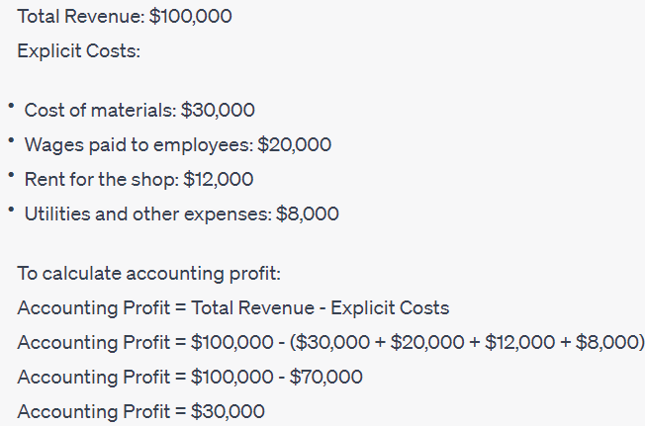
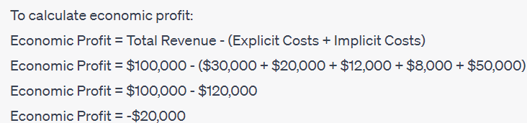
Concepts of Economics
1. Opportunity Cost
Suppose you have a small business selling handmade jewelry. Given year, your business experiences the following financials:
Accounting Profit
Economic Profit
Assume that before starting this jewelry business, you were offered a job with an annual salary of $50,000 in a financial firm. You turned down the job to pursue your business venture.
Fundamental Principles

Slide 10
1. Opportunity Cost
Concepts of Economics
Key Takeaways:
Accounting Profit VS Economic Profit
Accounting profit only considers explicit costs, while economic profit accounts for both explicit and implicit costs
Inclusion of Implicit Costs
Positive vs Negative Profit
Accounting profit can be positive even if economic profit is negative.
Decision-making Perspective
Economic profit is more relevant for decision-making because it reflects the real economic benefit.
Fundamental Principles

Slide 11
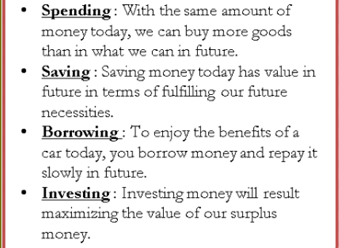
2. Time Value of Money
Concepts of Economics
Would you prefer to have Rs 1 million now or Rs 1 million 10 years from now?
Time preference for money is an individual’s preference for possession of a given amount of money now, rather than the same amount at some future time.
Four reasons may be attributed to the individual’s time preference for money:
Fundamental Principles

Slide 12

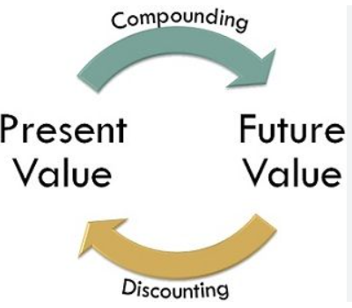
2. Time Value of Money
Concepts of Economics
Choosing from Different Alternatives
To make such comparisons, we must be able to compare the value of money at different point in time.
Fundamental Principles

Slide 13
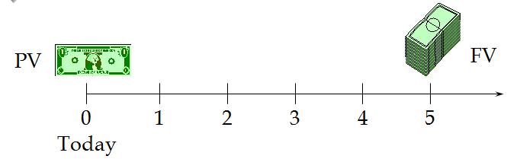
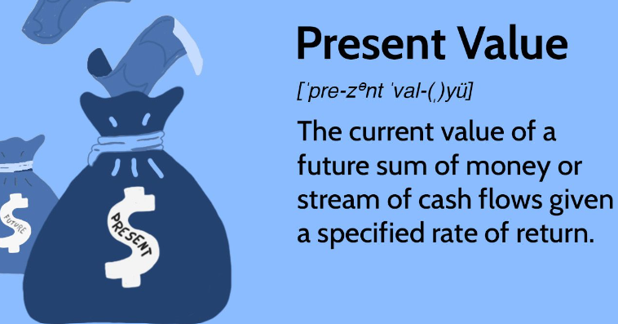
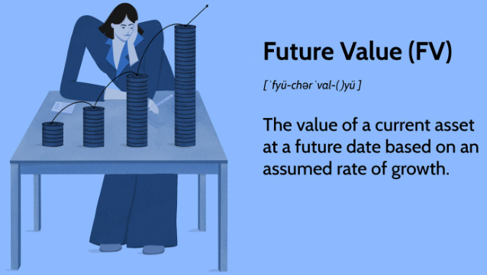
2. Time Value of Money
Concepts of Economics
Timelines
Fundamental Principles

Slide 14

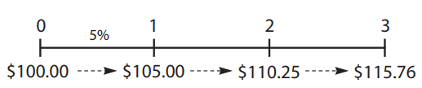
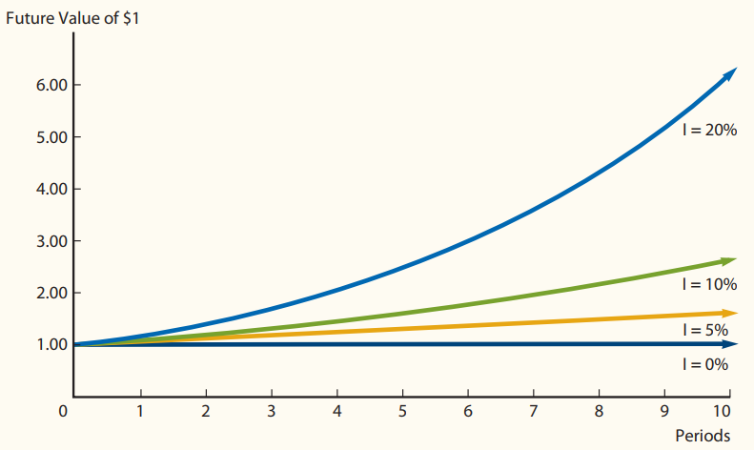


2. Time Value of Money
Concepts of Economics
Future Value of a lumpsum
$100 compounded for 3 years at 5%.
Formula
Fundamental Principles

Slide 15
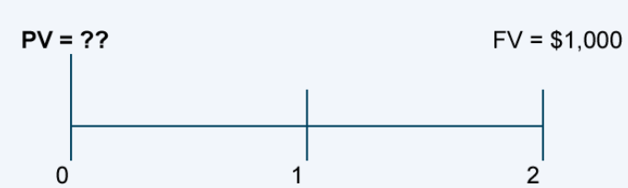
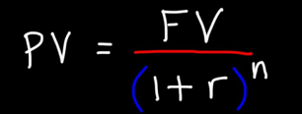
2. Time Value of Money
Concepts of Economics
Present Value of a lumpsum
Present value of $10,00 received two received from now at discount rate 10%.
Fundamental Principles

Slide 16
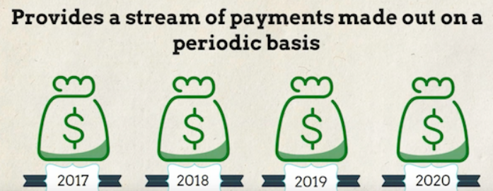
2. Time Value of Money
Concepts of Economics
Annuity
Fundamental Principles

Slide 17
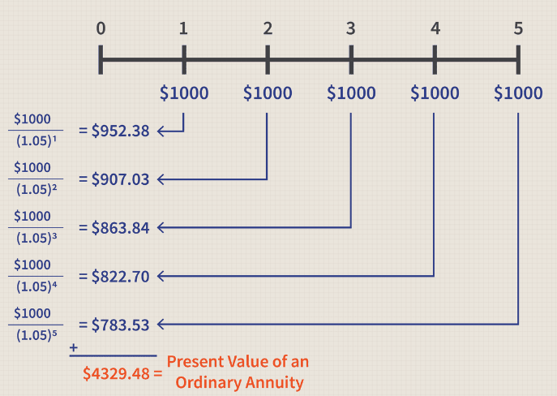
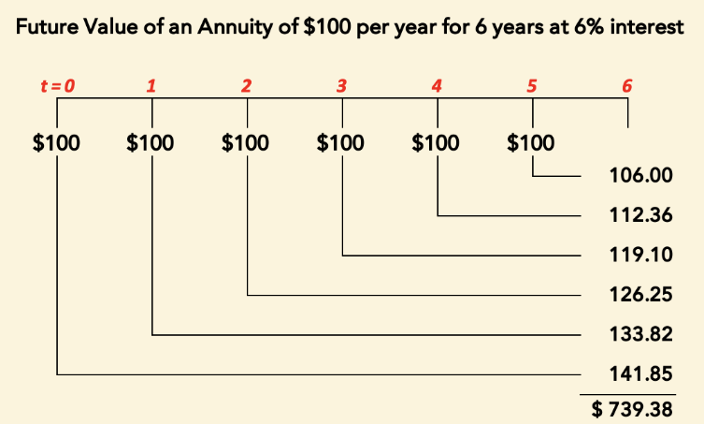
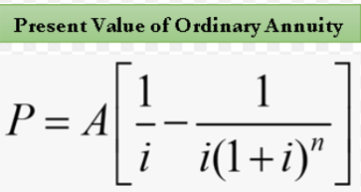
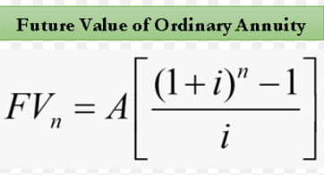
2. Time Value of Money
Concepts of Economics
Present Value of an annuity
Future Value of an annuity
Fundamental Principles

Slide 18
3. Incremental Reasoning
Concepts of Economics
Incremental reasoning involves making decisions based on the additional or incremental benefits and costs of a decision.
This approach helps in understanding the impact of small changes in decision-making processes.
Often used in optimizing resources and achieving the best possible outcomes in various economic activities.
Fundamental Principles

Slide 19
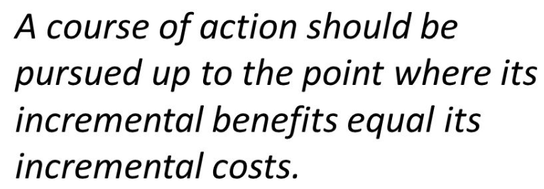
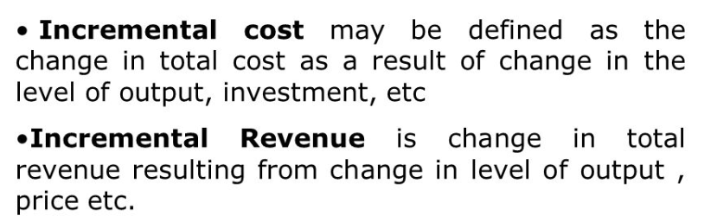
3. Incremental Reasoning
Concepts of Economics
Fundamental Principles

Slide 20
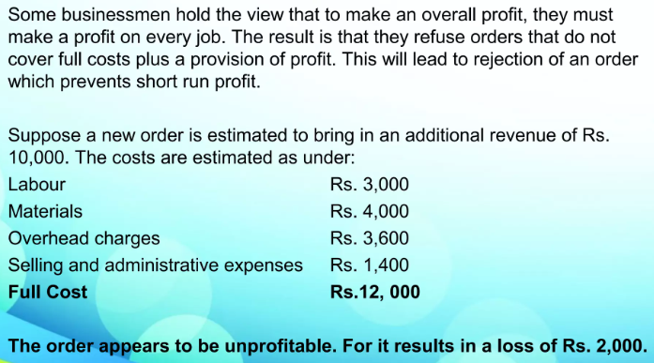
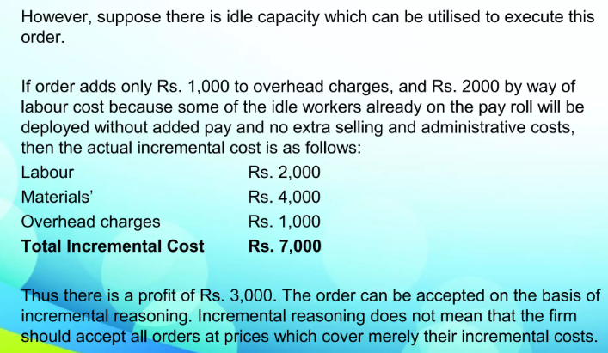
3. Incremental Reasoning
Concepts of Economics
Fundamental Principles

